Slide 1
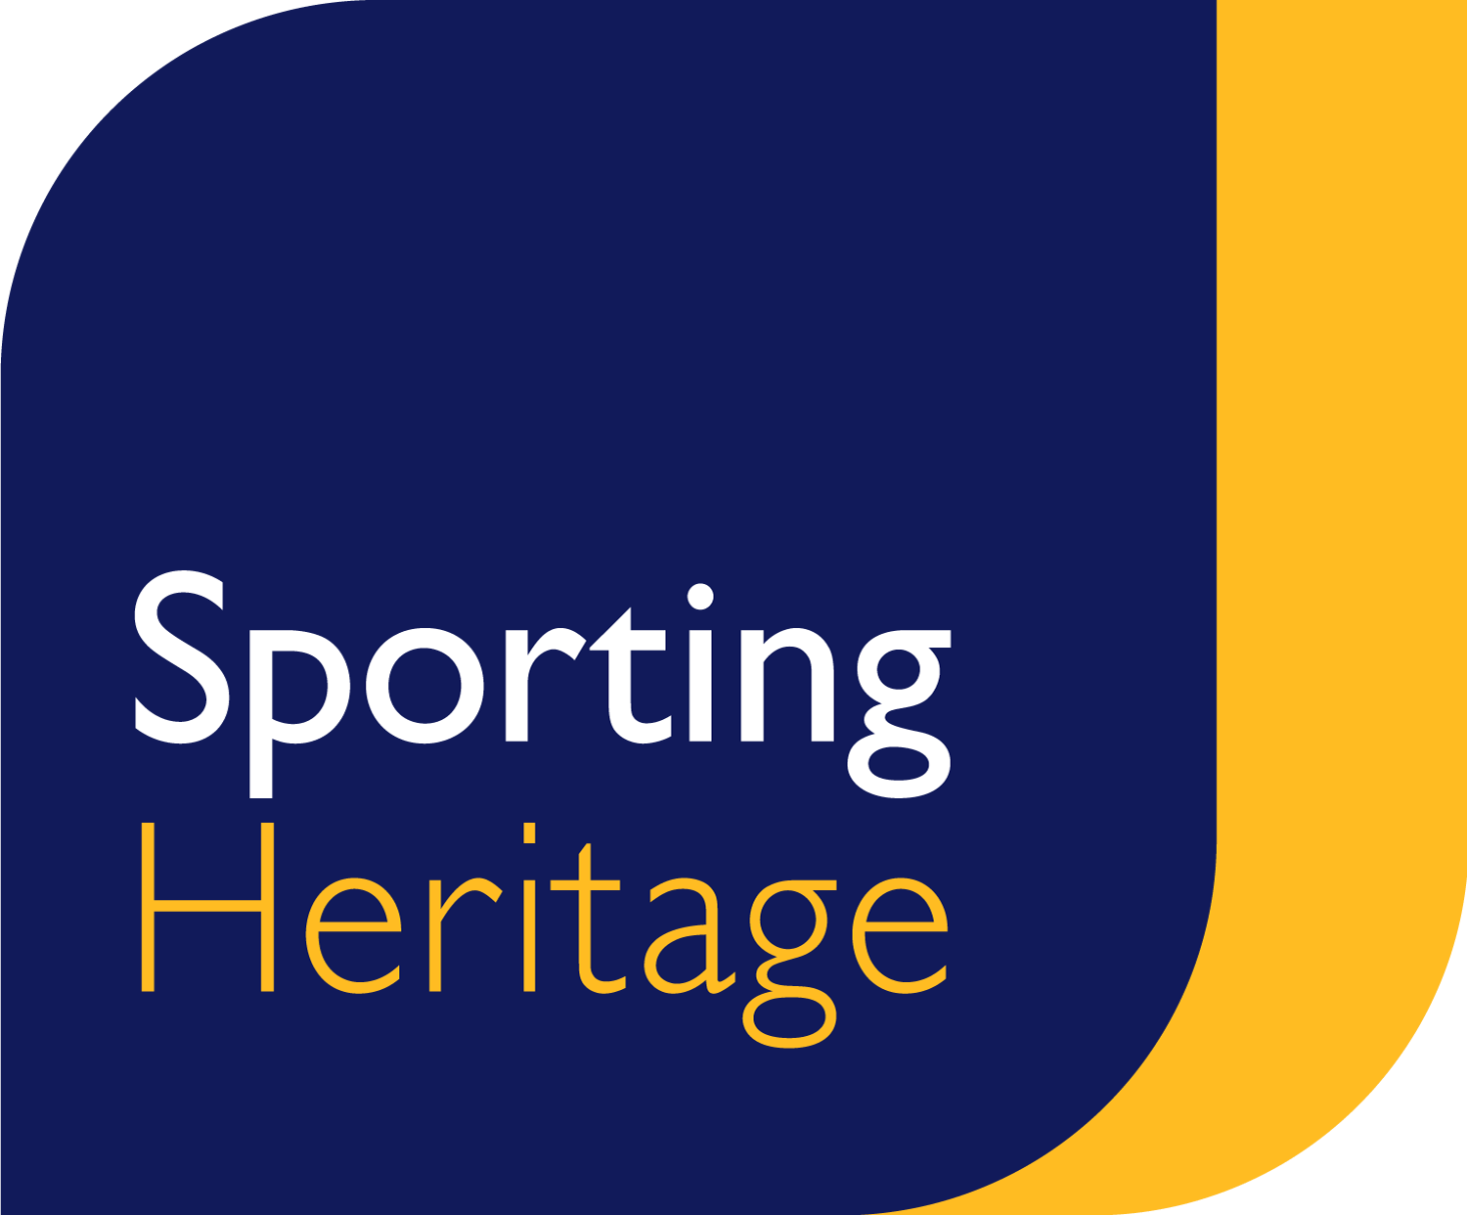
Dr Justine Reilly
Director
Sporting Heritage
Community Grants Webinar

Slide 2
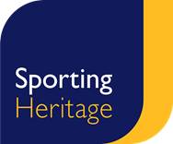
Housekeeping
We will be recording the webinar to share online
Please feel free to keep video off
Unless invited to unmute, please keep audio on mute at all times
Closed captions are on
The presentation will be shared with delegates
Please use the chat function for questions or comments
We have time for questions at the end of the presentation
Links will be shared in the chat
Notes:
So to the conference theme:
Over the last 12 months we have been working to better understand the true picture of sporting heritage across the UK. Our role as the sector support organisation is to look at the sector, understand the gaps and needs, and develop work – whether it be research, training, programmes or projects, which fill those gaps and needs.
We’ve understood since our inception really, and nothing brought this into sharper focus than Black Lives Matter, that sporting heritage collections are largely reflective of heritage as a whole – and that is white, middle class, straight, male, able bodied, neurotypical men.
That isn’t acceptable.
And much as there are pockets of excellent activity across the sector, the overwhelming representation within collections, audience and workforce is still not reflective of our society. It discriminates. It paints a picture of heritage and humankind which is neither realistic nor representative. It is not diverse and it is not equitable.
The issues here are three fold:
1. The accessibility of museum and heritage spaces as well as sport is not diverse. Research tells us time and time again that on the whole, the audiences and participants are white, economically wealthy, straight, and able bodied. So even though there have been countless activities and huge investment in changing this, and as we’ll see from the evaluation session later today, on the whole, this hasn’t changed. Why hasn’t it?
2. The reflection and representation of our collections and provision isn’t diverse. We’ve delivered a number of research and action programmes over the last couple of years looking specifically at the diversity of collections, and largely those collections aren’t diverse. So people of colour, neurodivergent people, disabled people, trans people, don’t see themselves reflected within provision.
3. So to workforce. The heritage sector has traditionally been elitist. I’ve lost count of the amount of times I’ve tried to argue that curatorial skills can be learnt from the age of 16 a Masters qualification should not grant you a key to access the heritage kingdom. Because if it does – we rule out 90% of society as part of our workforce before we even start. And if our workforce isn’t diverse, neither is anything else we do. We’re trying to change this through our kickstart programme – brining in 18 – 24 year olds who have excellent skills and potential and just need the chance to show it. But there is such a long way to go! You only have to look at the workforce represented here – it’s changing, that’s clear, we know we’re starting to make inroads, but it’s nowhere near good enough.
And so over the last 12 months we’ve delivered a range of programmes – you can see on your screens – to start to address this. Not just to understand, but to ask really specific questions about what’s wrong, why is it wrong, how do we change it, and who can help us.
All of this is now feeding into our strategic plan, and this conference will be crucial in providing more guidance and support for our next phase of work. But I want to assure you, we aren’t complacent. We will listen, we will work hard, and we will recognise when we get it wrong and work harder still.

Slide 3
Dr Justine Reilly
Director
Sporting Heritage
Community Grants Webinar

Slide 4
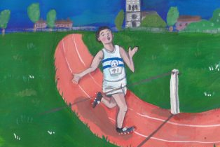
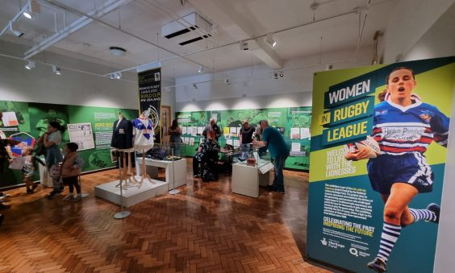
Coming up…
What are the Sporting Heritage Community Grants?
What do we want to achieve through the grants programme?
Who can apply for funding?
What can a community grant be used for?
How do I apply?
Questions
Notes:
So to the conference theme:
Over the last 12 months we have been working to better understand the true picture of sporting heritage across the UK. Our role as the sector support organisation is to look at the sector, understand the gaps and needs, and develop work – whether it be research, training, programmes or projects, which fill those gaps and needs.
We’ve understood since our inception really, and nothing brought this into sharper focus than Black Lives Matter, that sporting heritage collections are largely reflective of heritage as a whole – and that is white, middle class, straight, male, able bodied, neurotypical men.
That isn’t acceptable.
And much as there are pockets of excellent activity across the sector, the overwhelming representation within collections, audience and workforce is still not reflective of our society. It discriminates. It paints a picture of heritage and humankind which is neither realistic nor representative. It is not diverse and it is not equitable.
The issues here are three fold:
1. The accessibility of museum and heritage spaces as well as sport is not diverse. Research tells us time and time again that on the whole, the audiences and participants are white, economically wealthy, straight, and able bodied. So even though there have been countless activities and huge investment in changing this, and as we’ll see from the evaluation session later today, on the whole, this hasn’t changed. Why hasn’t it?
2. The reflection and representation of our collections and provision isn’t diverse. We’ve delivered a number of research and action programmes over the last couple of years looking specifically at the diversity of collections, and largely those collections aren’t diverse. So people of colour, neurodivergent people, disabled people, trans people, don’t see themselves reflected within provision.
3. So to workforce. The heritage sector has traditionally been elitist. I’ve lost count of the amount of times I’ve tried to argue that curatorial skills can be learnt from the age of 16 a Masters qualification should not grant you a key to access the heritage kingdom. Because if it does – we rule out 90% of society as part of our workforce before we even start. And if our workforce isn’t diverse, neither is anything else we do. We’re trying to change this through our kickstart programme – brining in 18 – 24 year olds who have excellent skills and potential and just need the chance to show it. But there is such a long way to go! You only have to look at the workforce represented here – it’s changing, that’s clear, we know we’re starting to make inroads, but it’s nowhere near good enough.
And so over the last 12 months we’ve delivered a range of programmes – you can see on your screens – to start to address this. Not just to understand, but to ask really specific questions about what’s wrong, why is it wrong, how do we change it, and who can help us.
All of this is now feeding into our strategic plan, and this conference will be crucial in providing more guidance and support for our next phase of work. But I want to assure you, we aren’t complacent. We will listen, we will work hard, and we will recognise when we get it wrong and work harder still.

Slide 5
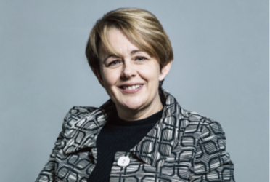
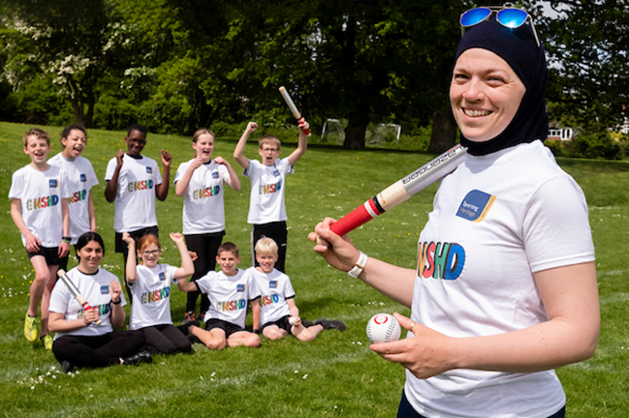
What are the Community Grants?
Funded by the Heritage Fund with the generous support of the players of the National Lottery!
The aim of the programme is to build a resilient sporting heritage sector which is protecting, preserving, sharing and celebrating a wide variety of sporting heritage
The funding will last for two years and will see us deliver three rounds of funding:
Spring 2024
Autumn 2024
Spring 2025
Notes:
So to the conference theme:
Over the last 12 months we have been working to better understand the true picture of sporting heritage across the UK. Our role as the sector support organisation is to look at the sector, understand the gaps and needs, and develop work – whether it be research, training, programmes or projects, which fill those gaps and needs.
We’ve understood since our inception really, and nothing brought this into sharper focus than Black Lives Matter, that sporting heritage collections are largely reflective of heritage as a whole – and that is white, middle class, straight, male, able bodied, neurotypical men.
That isn’t acceptable.
And much as there are pockets of excellent activity across the sector, the overwhelming representation within collections, audience and workforce is still not reflective of our society. It discriminates. It paints a picture of heritage and humankind which is neither realistic nor representative. It is not diverse and it is not equitable.
The issues here are three fold:
1. The accessibility of museum and heritage spaces as well as sport is not diverse. Research tells us time and time again that on the whole, the audiences and participants are white, economically wealthy, straight, and able bodied. So even though there have been countless activities and huge investment in changing this, and as we’ll see from the evaluation session later today, on the whole, this hasn’t changed. Why hasn’t it?
2. The reflection and representation of our collections and provision isn’t diverse. We’ve delivered a number of research and action programmes over the last couple of years looking specifically at the diversity of collections, and largely those collections aren’t diverse. So people of colour, neurodivergent people, disabled people, trans people, don’t see themselves reflected within provision.
3. So to workforce. The heritage sector has traditionally been elitist. I’ve lost count of the amount of times I’ve tried to argue that curatorial skills can be learnt from the age of 16 a Masters qualification should not grant you a key to access the heritage kingdom. Because if it does – we rule out 90% of society as part of our workforce before we even start. And if our workforce isn’t diverse, neither is anything else we do. We’re trying to change this through our kickstart programme – brining in 18 – 24 year olds who have excellent skills and potential and just need the chance to show it. But there is such a long way to go! You only have to look at the workforce represented here – it’s changing, that’s clear, we know we’re starting to make inroads, but it’s nowhere near good enough.
And so over the last 12 months we’ve delivered a range of programmes – you can see on your screens – to start to address this. Not just to understand, but to ask really specific questions about what’s wrong, why is it wrong, how do we change it, and who can help us.
All of this is now feeding into our strategic plan, and this conference will be crucial in providing more guidance and support for our next phase of work. But I want to assure you, we aren’t complacent. We will listen, we will work hard, and we will recognise when we get it wrong and work harder still.

Slide 6
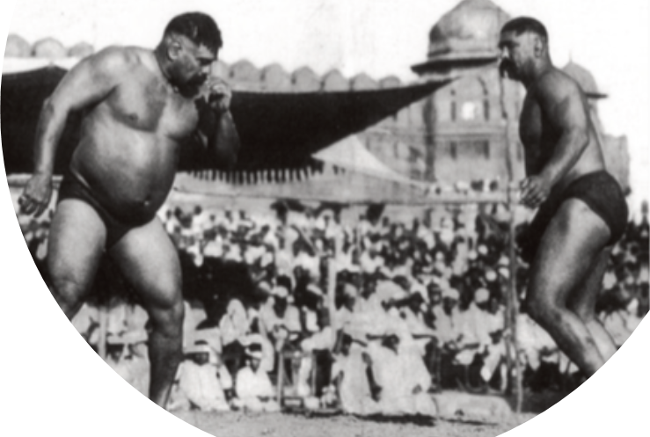
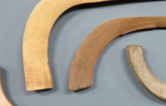
What do we want to achieve?
There are three key areas we’re looking to impact:
Sporting heritage is better protected and removed from risk
More and different people can access sporting heritage and tell their stories
Organisations working with sporting heritage are more resilient
Projects do not need to meet all three areas
Notes:
So to the conference theme:
Over the last 12 months we have been working to better understand the true picture of sporting heritage across the UK. Our role as the sector support organisation is to look at the sector, understand the gaps and needs, and develop work – whether it be research, training, programmes or projects, which fill those gaps and needs.
We’ve understood since our inception really, and nothing brought this into sharper focus than Black Lives Matter, that sporting heritage collections are largely reflective of heritage as a whole – and that is white, middle class, straight, male, able bodied, neurotypical men.
That isn’t acceptable.
And much as there are pockets of excellent activity across the sector, the overwhelming representation within collections, audience and workforce is still not reflective of our society. It discriminates. It paints a picture of heritage and humankind which is neither realistic nor representative. It is not diverse and it is not equitable.
The issues here are three fold:
1. The accessibility of museum and heritage spaces as well as sport is not diverse. Research tells us time and time again that on the whole, the audiences and participants are white, economically wealthy, straight, and able bodied. So even though there have been countless activities and huge investment in changing this, and as we’ll see from the evaluation session later today, on the whole, this hasn’t changed. Why hasn’t it?
2. The reflection and representation of our collections and provision isn’t diverse. We’ve delivered a number of research and action programmes over the last couple of years looking specifically at the diversity of collections, and largely those collections aren’t diverse. So people of colour, neurodivergent people, disabled people, trans people, don’t see themselves reflected within provision.
3. So to workforce. The heritage sector has traditionally been elitist. I’ve lost count of the amount of times I’ve tried to argue that curatorial skills can be learnt from the age of 16 a Masters qualification should not grant you a key to access the heritage kingdom. Because if it does – we rule out 90% of society as part of our workforce before we even start. And if our workforce isn’t diverse, neither is anything else we do. We’re trying to change this through our kickstart programme – brining in 18 – 24 year olds who have excellent skills and potential and just need the chance to show it. But there is such a long way to go! You only have to look at the workforce represented here – it’s changing, that’s clear, we know we’re starting to make inroads, but it’s nowhere near good enough.
And so over the last 12 months we’ve delivered a range of programmes – you can see on your screens – to start to address this. Not just to understand, but to ask really specific questions about what’s wrong, why is it wrong, how do we change it, and who can help us.
All of this is now feeding into our strategic plan, and this conference will be crucial in providing more guidance and support for our next phase of work. But I want to assure you, we aren’t complacent. We will listen, we will work hard, and we will recognise when we get it wrong and work harder still.

Slide 7
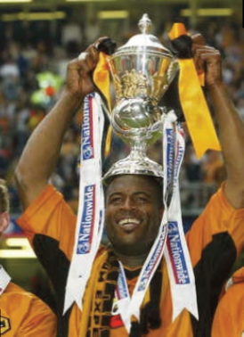
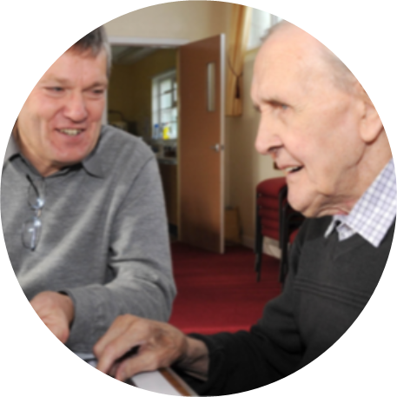
Who can apply for funding?
Grassroots sports, community and heritage organisations
Larger organisations who have a focus on engaging community organisations and co-curation
Constituted organisations can apply for funding, for example:
A formally constituted organisation such as a CIC or Charity
A society or group
You can also apply if you need the funding to move to a constituted organisation
Individuals cannot apply
Notes:
So to the conference theme:
Over the last 12 months we have been working to better understand the true picture of sporting heritage across the UK. Our role as the sector support organisation is to look at the sector, understand the gaps and needs, and develop work – whether it be research, training, programmes or projects, which fill those gaps and needs.
We’ve understood since our inception really, and nothing brought this into sharper focus than Black Lives Matter, that sporting heritage collections are largely reflective of heritage as a whole – and that is white, middle class, straight, male, able bodied, neurotypical men.
That isn’t acceptable.
And much as there are pockets of excellent activity across the sector, the overwhelming representation within collections, audience and workforce is still not reflective of our society. It discriminates. It paints a picture of heritage and humankind which is neither realistic nor representative. It is not diverse and it is not equitable.
The issues here are three fold:
1. The accessibility of museum and heritage spaces as well as sport is not diverse. Research tells us time and time again that on the whole, the audiences and participants are white, economically wealthy, straight, and able bodied. So even though there have been countless activities and huge investment in changing this, and as we’ll see from the evaluation session later today, on the whole, this hasn’t changed. Why hasn’t it?
2. The reflection and representation of our collections and provision isn’t diverse. We’ve delivered a number of research and action programmes over the last couple of years looking specifically at the diversity of collections, and largely those collections aren’t diverse. So people of colour, neurodivergent people, disabled people, trans people, don’t see themselves reflected within provision.
3. So to workforce. The heritage sector has traditionally been elitist. I’ve lost count of the amount of times I’ve tried to argue that curatorial skills can be learnt from the age of 16 a Masters qualification should not grant you a key to access the heritage kingdom. Because if it does – we rule out 90% of society as part of our workforce before we even start. And if our workforce isn’t diverse, neither is anything else we do. We’re trying to change this through our kickstart programme – brining in 18 – 24 year olds who have excellent skills and potential and just need the chance to show it. But there is such a long way to go! You only have to look at the workforce represented here – it’s changing, that’s clear, we know we’re starting to make inroads, but it’s nowhere near good enough.
And so over the last 12 months we’ve delivered a range of programmes – you can see on your screens – to start to address this. Not just to understand, but to ask really specific questions about what’s wrong, why is it wrong, how do we change it, and who can help us.
All of this is now feeding into our strategic plan, and this conference will be crucial in providing more guidance and support for our next phase of work. But I want to assure you, we aren’t complacent. We will listen, we will work hard, and we will recognise when we get it wrong and work harder still.

Slide 8
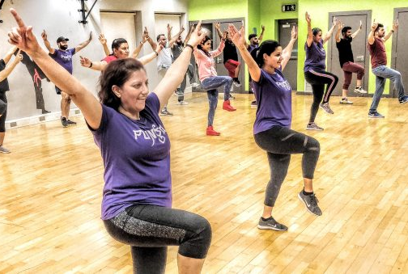
What can I apply for?
Projects which are rooted in their community and focus on sporting heritage, can apply for a community grant
The sporting heritage involved can be:
tangible heritage, such as spaces, objects and film
intangible heritage such as oral history, songs, and folklore
Or a combination of the above
Community can mean a geographical space or a community of people
There must be a focus on sporting heritage – we can’t fund projects which only have a focus on sport or on heritage
We encourage projects to think about how they might link to National Sporting Heritage Day or themed months
Notes:
So to the conference theme:
Over the last 12 months we have been working to better understand the true picture of sporting heritage across the UK. Our role as the sector support organisation is to look at the sector, understand the gaps and needs, and develop work – whether it be research, training, programmes or projects, which fill those gaps and needs.
We’ve understood since our inception really, and nothing brought this into sharper focus than Black Lives Matter, that sporting heritage collections are largely reflective of heritage as a whole – and that is white, middle class, straight, male, able bodied, neurotypical men.
That isn’t acceptable.
And much as there are pockets of excellent activity across the sector, the overwhelming representation within collections, audience and workforce is still not reflective of our society. It discriminates. It paints a picture of heritage and humankind which is neither realistic nor representative. It is not diverse and it is not equitable.
The issues here are three fold:
1. The accessibility of museum and heritage spaces as well as sport is not diverse. Research tells us time and time again that on the whole, the audiences and participants are white, economically wealthy, straight, and able bodied. So even though there have been countless activities and huge investment in changing this, and as we’ll see from the evaluation session later today, on the whole, this hasn’t changed. Why hasn’t it?
2. The reflection and representation of our collections and provision isn’t diverse. We’ve delivered a number of research and action programmes over the last couple of years looking specifically at the diversity of collections, and largely those collections aren’t diverse. So people of colour, neurodivergent people, disabled people, trans people, don’t see themselves reflected within provision.
3. So to workforce. The heritage sector has traditionally been elitist. I’ve lost count of the amount of times I’ve tried to argue that curatorial skills can be learnt from the age of 16 a Masters qualification should not grant you a key to access the heritage kingdom. Because if it does – we rule out 90% of society as part of our workforce before we even start. And if our workforce isn’t diverse, neither is anything else we do. We’re trying to change this through our kickstart programme – brining in 18 – 24 year olds who have excellent skills and potential and just need the chance to show it. But there is such a long way to go! You only have to look at the workforce represented here – it’s changing, that’s clear, we know we’re starting to make inroads, but it’s nowhere near good enough.
And so over the last 12 months we’ve delivered a range of programmes – you can see on your screens – to start to address this. Not just to understand, but to ask really specific questions about what’s wrong, why is it wrong, how do we change it, and who can help us.
All of this is now feeding into our strategic plan, and this conference will be crucial in providing more guidance and support for our next phase of work. But I want to assure you, we aren’t complacent. We will listen, we will work hard, and we will recognise when we get it wrong and work harder still.

Slide 9
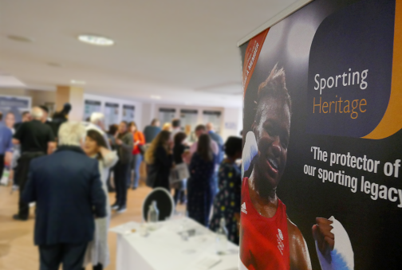
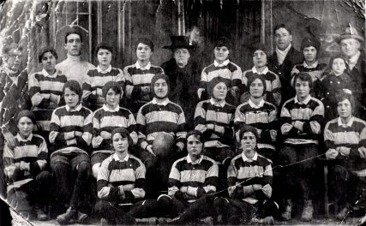
What can I apply for?
We’re looking for projects that will make a real difference
This could be:
The very beginnings of your work with sporting heritage
Working with a new audience or community
The culmination of activity you’ve been working on
Testing a new way of working
Presenting sporting heritage in a new way
And we are particularly interested in projects from, or which work with, communities which are currently under-represented
For examples of previous community grants, visit:
https://www.sportingheritage.org.uk/content/category/events/national-sporting-heritage-day/explore-past-events
Notes:
So to the conference theme:
Over the last 12 months we have been working to better understand the true picture of sporting heritage across the UK. Our role as the sector support organisation is to look at the sector, understand the gaps and needs, and develop work – whether it be research, training, programmes or projects, which fill those gaps and needs.
We’ve understood since our inception really, and nothing brought this into sharper focus than Black Lives Matter, that sporting heritage collections are largely reflective of heritage as a whole – and that is white, middle class, straight, male, able bodied, neurotypical men.
That isn’t acceptable.
And much as there are pockets of excellent activity across the sector, the overwhelming representation within collections, audience and workforce is still not reflective of our society. It discriminates. It paints a picture of heritage and humankind which is neither realistic nor representative. It is not diverse and it is not equitable.
The issues here are three fold:
1. The accessibility of museum and heritage spaces as well as sport is not diverse. Research tells us time and time again that on the whole, the audiences and participants are white, economically wealthy, straight, and able bodied. So even though there have been countless activities and huge investment in changing this, and as we’ll see from the evaluation session later today, on the whole, this hasn’t changed. Why hasn’t it?
2. The reflection and representation of our collections and provision isn’t diverse. We’ve delivered a number of research and action programmes over the last couple of years looking specifically at the diversity of collections, and largely those collections aren’t diverse. So people of colour, neurodivergent people, disabled people, trans people, don’t see themselves reflected within provision.
3. So to workforce. The heritage sector has traditionally been elitist. I’ve lost count of the amount of times I’ve tried to argue that curatorial skills can be learnt from the age of 16 a Masters qualification should not grant you a key to access the heritage kingdom. Because if it does – we rule out 90% of society as part of our workforce before we even start. And if our workforce isn’t diverse, neither is anything else we do. We’re trying to change this through our kickstart programme – brining in 18 – 24 year olds who have excellent skills and potential and just need the chance to show it. But there is such a long way to go! You only have to look at the workforce represented here – it’s changing, that’s clear, we know we’re starting to make inroads, but it’s nowhere near good enough.
And so over the last 12 months we’ve delivered a range of programmes – you can see on your screens – to start to address this. Not just to understand, but to ask really specific questions about what’s wrong, why is it wrong, how do we change it, and who can help us.
All of this is now feeding into our strategic plan, and this conference will be crucial in providing more guidance and support for our next phase of work. But I want to assure you, we aren’t complacent. We will listen, we will work hard, and we will recognise when we get it wrong and work harder still.

Slide 10
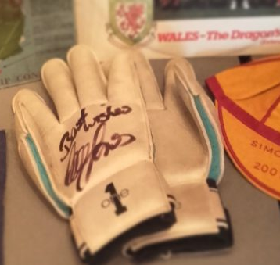
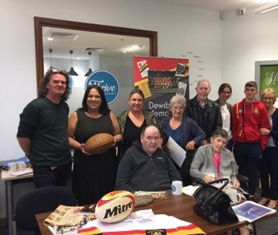
What can I apply for?
All projects should start no sooner than the 1st September 2024 and be completed no later than the 28th February 2025
You can apply for a whole range of things to support your project’s delivery, including:
Staffing (new staff), to backfill posts, or to engage specialist consultants / professionals
IT and softwear
Equipment and kit – for example to record oral histories or to display an exhibition
Creating resources
Marketing and publicity
Catering and room hire
Organisational costs (for example if you’re creating a CIC, registration costs)
Access costs
Travel and transport
Notes:
So to the conference theme:
Over the last 12 months we have been working to better understand the true picture of sporting heritage across the UK. Our role as the sector support organisation is to look at the sector, understand the gaps and needs, and develop work – whether it be research, training, programmes or projects, which fill those gaps and needs.
We’ve understood since our inception really, and nothing brought this into sharper focus than Black Lives Matter, that sporting heritage collections are largely reflective of heritage as a whole – and that is white, middle class, straight, male, able bodied, neurotypical men.
That isn’t acceptable.
And much as there are pockets of excellent activity across the sector, the overwhelming representation within collections, audience and workforce is still not reflective of our society. It discriminates. It paints a picture of heritage and humankind which is neither realistic nor representative. It is not diverse and it is not equitable.
The issues here are three fold:
1. The accessibility of museum and heritage spaces as well as sport is not diverse. Research tells us time and time again that on the whole, the audiences and participants are white, economically wealthy, straight, and able bodied. So even though there have been countless activities and huge investment in changing this, and as we’ll see from the evaluation session later today, on the whole, this hasn’t changed. Why hasn’t it?
2. The reflection and representation of our collections and provision isn’t diverse. We’ve delivered a number of research and action programmes over the last couple of years looking specifically at the diversity of collections, and largely those collections aren’t diverse. So people of colour, neurodivergent people, disabled people, trans people, don’t see themselves reflected within provision.
3. So to workforce. The heritage sector has traditionally been elitist. I’ve lost count of the amount of times I’ve tried to argue that curatorial skills can be learnt from the age of 16 a Masters qualification should not grant you a key to access the heritage kingdom. Because if it does – we rule out 90% of society as part of our workforce before we even start. And if our workforce isn’t diverse, neither is anything else we do. We’re trying to change this through our kickstart programme – brining in 18 – 24 year olds who have excellent skills and potential and just need the chance to show it. But there is such a long way to go! You only have to look at the workforce represented here – it’s changing, that’s clear, we know we’re starting to make inroads, but it’s nowhere near good enough.
And so over the last 12 months we’ve delivered a range of programmes – you can see on your screens – to start to address this. Not just to understand, but to ask really specific questions about what’s wrong, why is it wrong, how do we change it, and who can help us.
All of this is now feeding into our strategic plan, and this conference will be crucial in providing more guidance and support for our next phase of work. But I want to assure you, we aren’t complacent. We will listen, we will work hard, and we will recognise when we get it wrong and work harder still.

Slide 11
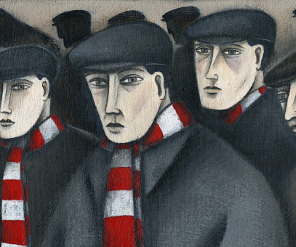
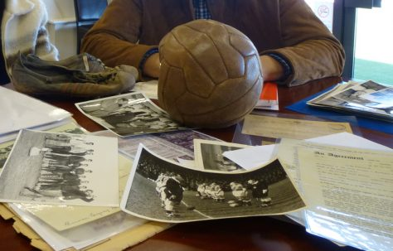
What can I apply for?
Main grant fund: Applicants can apply for a maximum of £500 to support their project ideas.
Large grant fund: Applicants can apply for a maximum of £3000 to support their project ideas.
You can apply up to the maximum amount of the funding strands and for the amount you need
Applicants can only apply to one strand in each funding round
We expect there will be more applications than the funding we have to allocate
You do not need to demonstrate match funding, and applicants will not be assessed on their ability to do so
If you have funding from other sources though, or are hoping to attract additional funding to complete your project, it’s helpful to say this in your application so we can see where and how our funding will support you
Notes:
So to the conference theme:
Over the last 12 months we have been working to better understand the true picture of sporting heritage across the UK. Our role as the sector support organisation is to look at the sector, understand the gaps and needs, and develop work – whether it be research, training, programmes or projects, which fill those gaps and needs.
We’ve understood since our inception really, and nothing brought this into sharper focus than Black Lives Matter, that sporting heritage collections are largely reflective of heritage as a whole – and that is white, middle class, straight, male, able bodied, neurotypical men.
That isn’t acceptable.
And much as there are pockets of excellent activity across the sector, the overwhelming representation within collections, audience and workforce is still not reflective of our society. It discriminates. It paints a picture of heritage and humankind which is neither realistic nor representative. It is not diverse and it is not equitable.
The issues here are three fold:
1. The accessibility of museum and heritage spaces as well as sport is not diverse. Research tells us time and time again that on the whole, the audiences and participants are white, economically wealthy, straight, and able bodied. So even though there have been countless activities and huge investment in changing this, and as we’ll see from the evaluation session later today, on the whole, this hasn’t changed. Why hasn’t it?
2. The reflection and representation of our collections and provision isn’t diverse. We’ve delivered a number of research and action programmes over the last couple of years looking specifically at the diversity of collections, and largely those collections aren’t diverse. So people of colour, neurodivergent people, disabled people, trans people, don’t see themselves reflected within provision.
3. So to workforce. The heritage sector has traditionally been elitist. I’ve lost count of the amount of times I’ve tried to argue that curatorial skills can be learnt from the age of 16 a Masters qualification should not grant you a key to access the heritage kingdom. Because if it does – we rule out 90% of society as part of our workforce before we even start. And if our workforce isn’t diverse, neither is anything else we do. We’re trying to change this through our kickstart programme – brining in 18 – 24 year olds who have excellent skills and potential and just need the chance to show it. But there is such a long way to go! You only have to look at the workforce represented here – it’s changing, that’s clear, we know we’re starting to make inroads, but it’s nowhere near good enough.
And so over the last 12 months we’ve delivered a range of programmes – you can see on your screens – to start to address this. Not just to understand, but to ask really specific questions about what’s wrong, why is it wrong, how do we change it, and who can help us.
All of this is now feeding into our strategic plan, and this conference will be crucial in providing more guidance and support for our next phase of work. But I want to assure you, we aren’t complacent. We will listen, we will work hard, and we will recognise when we get it wrong and work harder still.

Slide 12
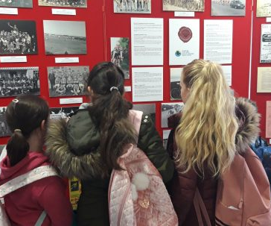
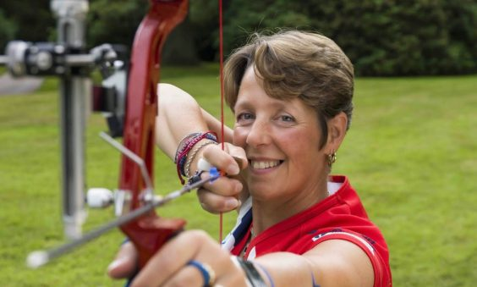
How do I apply?
Deadline for Round 1 is 12pm on the 7th June
Successful applicants will be notified by the end of June 2024
Reporting is straightforward
The application form can be found here:
https://www.surveymonkey.com/r/SHGrants124
Notes:
So to the conference theme:
Over the last 12 months we have been working to better understand the true picture of sporting heritage across the UK. Our role as the sector support organisation is to look at the sector, understand the gaps and needs, and develop work – whether it be research, training, programmes or projects, which fill those gaps and needs.
We’ve understood since our inception really, and nothing brought this into sharper focus than Black Lives Matter, that sporting heritage collections are largely reflective of heritage as a whole – and that is white, middle class, straight, male, able bodied, neurotypical men.
That isn’t acceptable.
And much as there are pockets of excellent activity across the sector, the overwhelming representation within collections, audience and workforce is still not reflective of our society. It discriminates. It paints a picture of heritage and humankind which is neither realistic nor representative. It is not diverse and it is not equitable.
The issues here are three fold:
1. The accessibility of museum and heritage spaces as well as sport is not diverse. Research tells us time and time again that on the whole, the audiences and participants are white, economically wealthy, straight, and able bodied. So even though there have been countless activities and huge investment in changing this, and as we’ll see from the evaluation session later today, on the whole, this hasn’t changed. Why hasn’t it?
2. The reflection and representation of our collections and provision isn’t diverse. We’ve delivered a number of research and action programmes over the last couple of years looking specifically at the diversity of collections, and largely those collections aren’t diverse. So people of colour, neurodivergent people, disabled people, trans people, don’t see themselves reflected within provision.
3. So to workforce. The heritage sector has traditionally been elitist. I’ve lost count of the amount of times I’ve tried to argue that curatorial skills can be learnt from the age of 16 a Masters qualification should not grant you a key to access the heritage kingdom. Because if it does – we rule out 90% of society as part of our workforce before we even start. And if our workforce isn’t diverse, neither is anything else we do. We’re trying to change this through our kickstart programme – brining in 18 – 24 year olds who have excellent skills and potential and just need the chance to show it. But there is such a long way to go! You only have to look at the workforce represented here – it’s changing, that’s clear, we know we’re starting to make inroads, but it’s nowhere near good enough.
And so over the last 12 months we’ve delivered a range of programmes – you can see on your screens – to start to address this. Not just to understand, but to ask really specific questions about what’s wrong, why is it wrong, how do we change it, and who can help us.
All of this is now feeding into our strategic plan, and this conference will be crucial in providing more guidance and support for our next phase of work. But I want to assure you, we aren’t complacent. We will listen, we will work hard, and we will recognise when we get it wrong and work harder still.

Slide 13
Key points
Focus on sporting heritage
Projects to run between 1st sept 24 & 28th Feb 25
Two strands of funding: up to £500 or up to £3000
Deadline 12pm on the 7th June
Apply here:
https://www.surveymonkey.com/r/SHGrants124
Notes:
So to the conference theme:
Over the last 12 months we have been working to better understand the true picture of sporting heritage across the UK. Our role as the sector support organisation is to look at the sector, understand the gaps and needs, and develop work – whether it be research, training, programmes or projects, which fill those gaps and needs.
We’ve understood since our inception really, and nothing brought this into sharper focus than Black Lives Matter, that sporting heritage collections are largely reflective of heritage as a whole – and that is white, middle class, straight, male, able bodied, neurotypical men.
That isn’t acceptable.
And much as there are pockets of excellent activity across the sector, the overwhelming representation within collections, audience and workforce is still not reflective of our society. It discriminates. It paints a picture of heritage and humankind which is neither realistic nor representative. It is not diverse and it is not equitable.
The issues here are three fold:
1. The accessibility of museum and heritage spaces as well as sport is not diverse. Research tells us time and time again that on the whole, the audiences and participants are white, economically wealthy, straight, and able bodied. So even though there have been countless activities and huge investment in changing this, and as we’ll see from the evaluation session later today, on the whole, this hasn’t changed. Why hasn’t it?
2. The reflection and representation of our collections and provision isn’t diverse. We’ve delivered a number of research and action programmes over the last couple of years looking specifically at the diversity of collections, and largely those collections aren’t diverse. So people of colour, neurodivergent people, disabled people, trans people, don’t see themselves reflected within provision.
3. So to workforce. The heritage sector has traditionally been elitist. I’ve lost count of the amount of times I’ve tried to argue that curatorial skills can be learnt from the age of 16 a Masters qualification should not grant you a key to access the heritage kingdom. Because if it does – we rule out 90% of society as part of our workforce before we even start. And if our workforce isn’t diverse, neither is anything else we do. We’re trying to change this through our kickstart programme – brining in 18 – 24 year olds who have excellent skills and potential and just need the chance to show it. But there is such a long way to go! You only have to look at the workforce represented here – it’s changing, that’s clear, we know we’re starting to make inroads, but it’s nowhere near good enough.
And so over the last 12 months we’ve delivered a range of programmes – you can see on your screens – to start to address this. Not just to understand, but to ask really specific questions about what’s wrong, why is it wrong, how do we change it, and who can help us.
All of this is now feeding into our strategic plan, and this conference will be crucial in providing more guidance and support for our next phase of work. But I want to assure you, we aren’t complacent. We will listen, we will work hard, and we will recognise when we get it wrong and work harder still.

Slide 14
Questions!

