Slide 1
Art and Sporting Heritage

Slide 2
‘The time has come to enter a new phase and restore the Olympiads to their original beauty. At the time of Olympia’s splendour… the arts and literature joined with sport to ensure the greatness of the Olympic Games. The same must be true in the future.’
Pierre De Coubertin, 1904
Pierre de Coubertin 1904

Slide 3
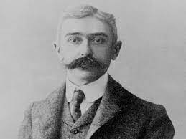
Baron Pierre de Coubertin, the founder of the modern Olympic Games in 1896 believed that there was a special relationship between sport and art.

Slide 4
His vision of combining ‘muscles and mind’ meant that between 1912 and 1948 all the Games also included Olympic competitions in art, sculpture, architecture, literature and music.

Slide 5
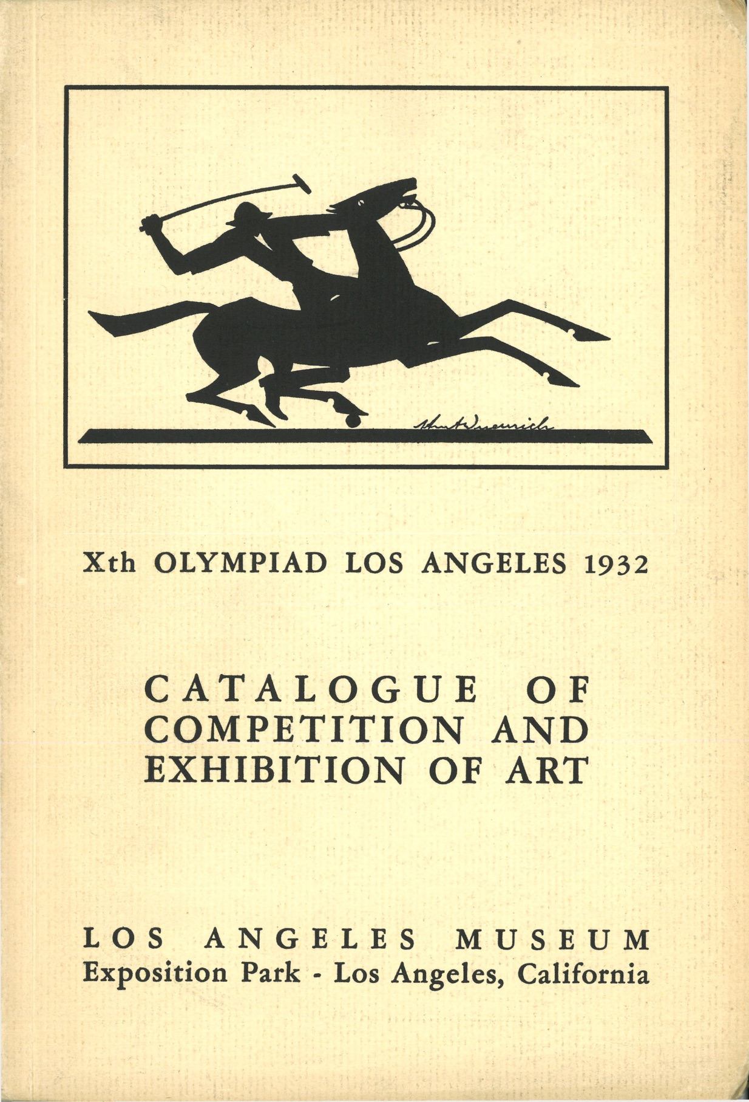
Exhibition of entries and the Competition Catalogue for the 1932 Olympic Games at Los Angles
The Olympic Museum

Slide 6
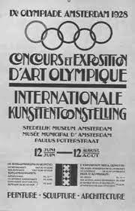
Competition Catalogues for the Olympic Games in London, 1948 and Amsterdam, 1928 The Olympic Museum

Slide 7
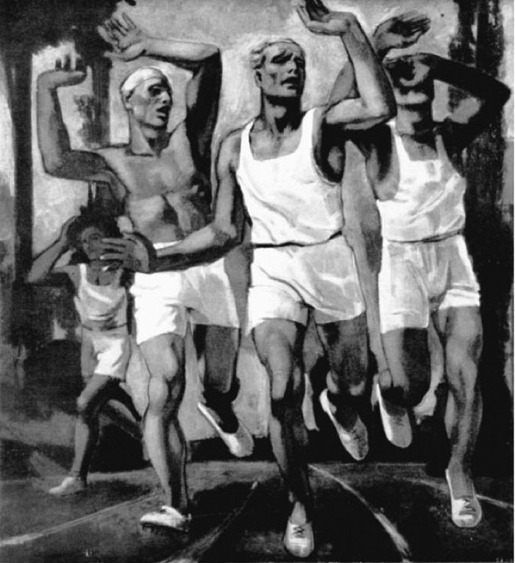
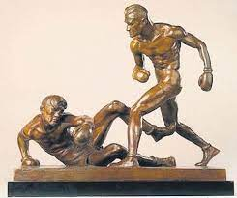
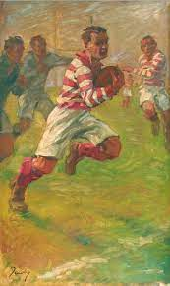
Competitors’ entries had to be related to images of sport and gold, sliver and bronze medals were awarded by judges…
Rudolf Herman Eisenmenger (Austria)
1936 Silver ‘Runners at the Finish Line’
Mahonri Young (USA) 1932 Gold ‘The Knockdown’, The Smithsonian American Art Museum
Jean Jackoby (Luxembourg)
1928 Gold ‘Rugby’, The
Olympic Museum

Slide 8
Over to you! Get creative…
Over to you to share your vision and creative ideas to show the connection between sport and art…
And create your own sporting heritage gallery!

Slide 9
Step 1
Research and choose a famous Olympic, Paralympic or other sporting moment from the past…

Slide 10
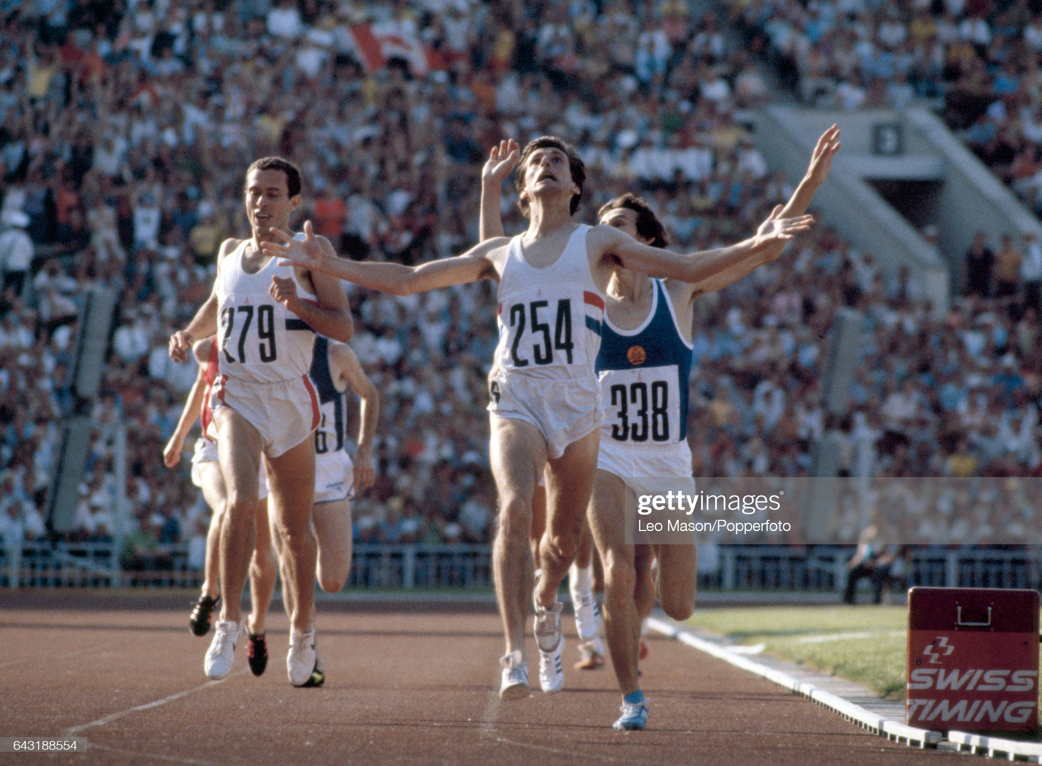

Slide 11
Step 2
Research and choose an artist or artistic style that you think best matches the moment you have chosen and would be a creative way to represent it as a piece of art…

Slide 12
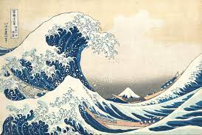
Katsushika Hokusai, The Great Wave (1831)

Slide 13
Edvard Munch, The Scream (1893)

Slide 14
Step 3
Create your own artistic interpretation of the moment in your chosen artistic style…

Slide 15
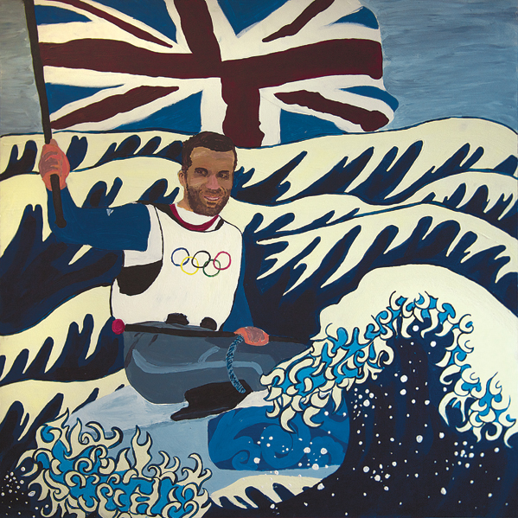
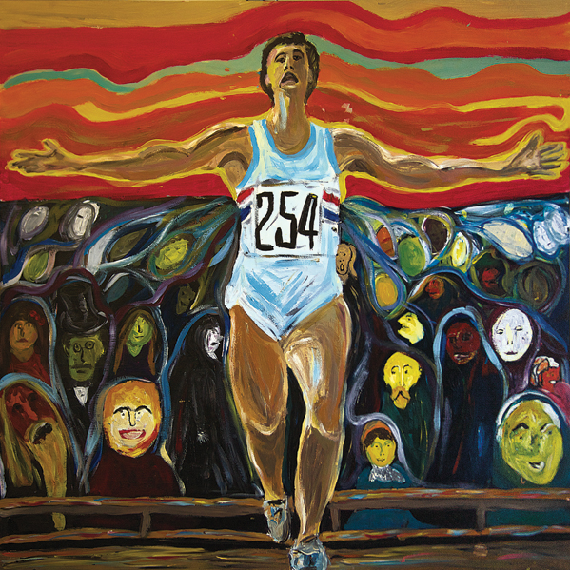

Slide 16
Thinking creatively
If you prefer…
Research more about the history of sport in your local area or other sports that you love.
Is there a famous stadium or venue, sportsperson or event that you could produce a piece of art to represent?
Or what about sporting events that have taken place in your school?

Slide 17
Thinking further
Find out more about the Olympic Art Competitions that took place between 1912 and 1948. Produce a display to explain them.
If there was an Olympic art competition today, what do think it might include?

