Slide 1
Sporting Heritage
Dr Justine Reilly, Sporting Heritage

Slide 2
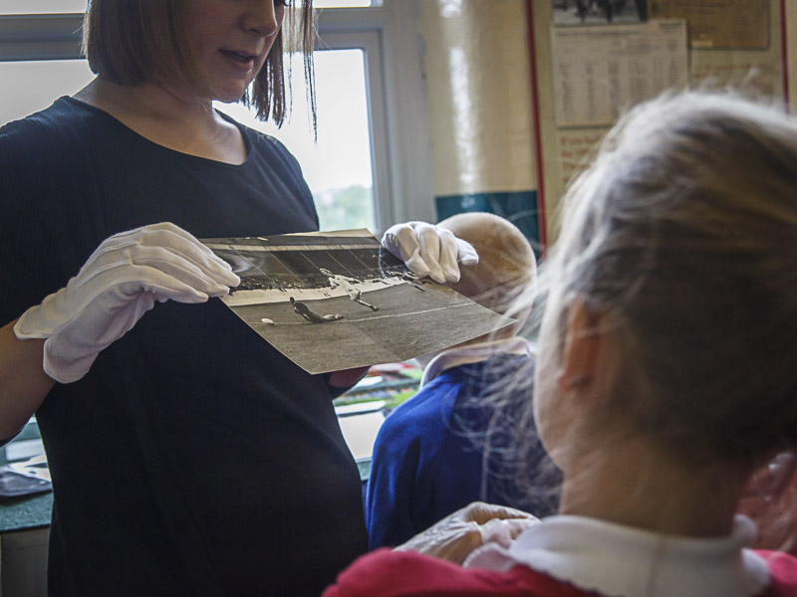
Our Mission
Sporting Heritage aims to support the protection, collection, preservation, research, and access of sporting heritage across the UK
We work to demonstrate and increase opportunities for sporting heritage to respond to a range of agendas including education, community engagement and health and wellbeing

Slide 3
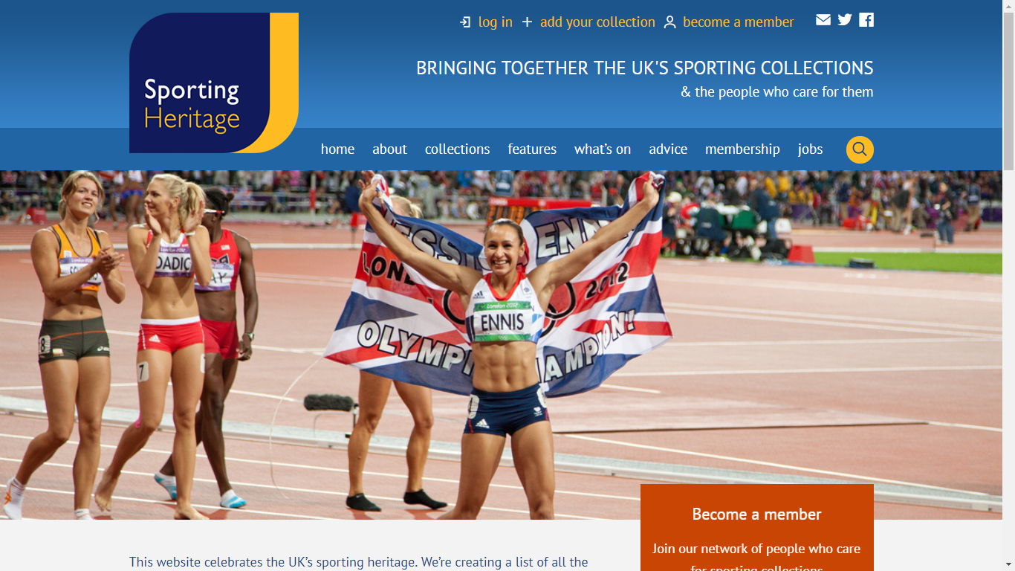
What we do….
Draw together all information regarding sporting heritage collections, news, policy, research and impact on our website www.sportingheritage.org.uk
Manage a network of nations and regions hubs across the UK
Deliver a programme of events & conferences
Support training, mentoring programme, volunteering and career development within the sector
Manage a membership programme
Manage an AHRC funded research programme
Manage and deliver National Sporting Heritage Day
Manage and deliver targeted projects

Slide 4
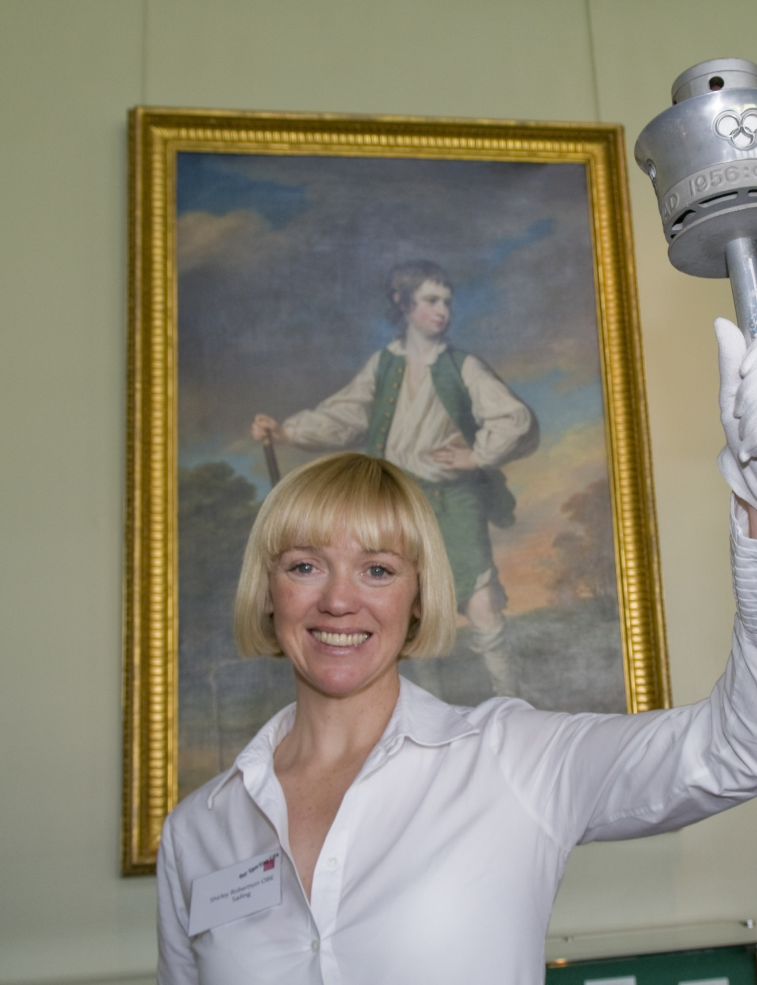
What is sporting heritage?
Objects
Archives
Intangible heritage
Memories
Stories
Songs
Folklore
Buildings and structures

Slide 5
Why is sporting heritage relevant to the health and wellbeing agenda?
The subject of sport resonates with individuals and communities for a plethora or reasons:
It is often embedded in the sense of self, pride and community
The sporting past is linked to life’s highs and lows and the emotions therein
It is a subject matter that attracts non-traditional heritage audiences to access their heritage
It is not only the theme of sport which is told through sporting heritage but wider social, political, and economic histories

Slide 6
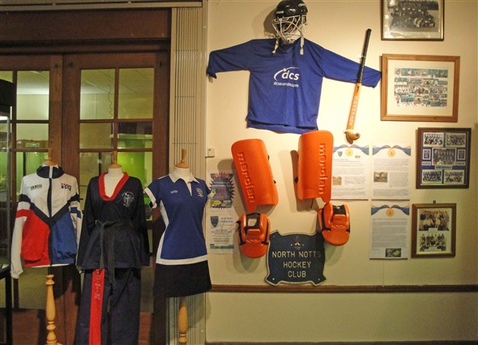
Supporting physical wellbeing – increasing sports participation

Slide 7
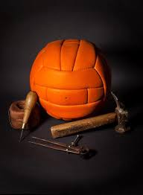
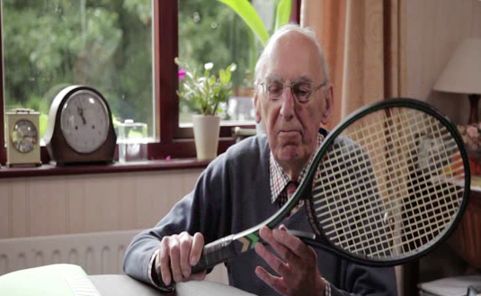
Increasing opportunities for community engagement, opening up hidden histories and decreasing isolation

Slide 8
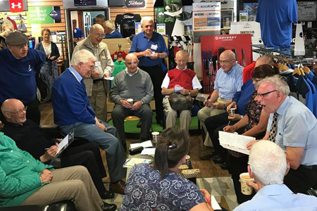
Sporting heritage and reminiscence

Slide 9
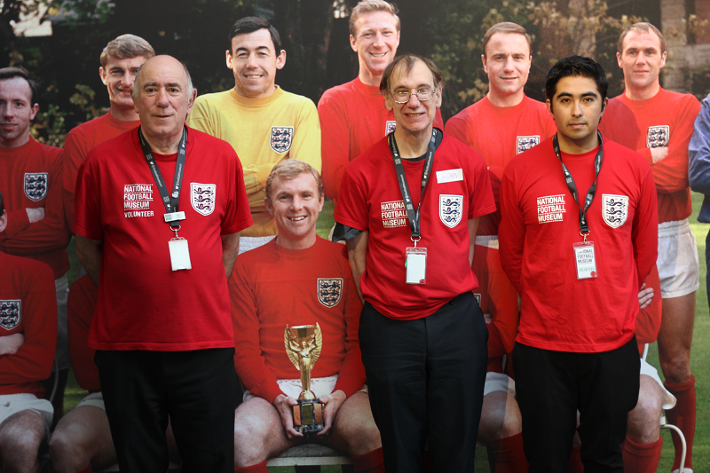
Increasing opportunities to support training and volunteering
Image courtesy of the National Football Museum

Slide 10
Key Outcomes
Increases opportunities which benefit physical wellbeing through new access to sports participation
Provides opportunities which decrease isolation
Is unique in its ability to support reminiscence activity amongst a range of different audiences
Ensuring that individuals and communities feel valued, have a sense of self, and are able to relate to each other through the lens of sporting heritage
Increases access to heritage and culture
Increases volunteering opportunities
Increases training and skills opportunities

Slide 11
How to get involved
National Sporting Heritage Day
Become a member
Our conference November 2018
Join our nations and regions networks
Take part in our Sporting Heritage and the Armed Forces project

Slide 12
Dr Justine Reilly, Director Sporting Heritage
www.sportingheritage.org.uk
Twitter: @sportinghistory
Facebook:
Sporting Heritage
justine@sportingheritage.org.uk
Keep in touch!

